Slide 1
UE18CS202-DATA STRUCTURES
TOPIC: ONLINE EQUIVALENCE CLASSES
By:
Nitish S (PES2201800368)
Sandeep Bhat (PES2201800632)
CLASS: 3rd sem, ‘A’

Slide 2
ONLINE EQUIVALENCE CLASSES
Online equivalence classes is also called as the Union-Find problem.
We initially begin with ‘n’ elements numbered 1 through n, each of which is in a class of its own.
A sequence of Union and Find operations can be performed wherein:
->The Union operation on two given elements combine the classes to which the two elements belong to.
->The Find operation returns the unique class to which a given element belongs to.

Slide 3
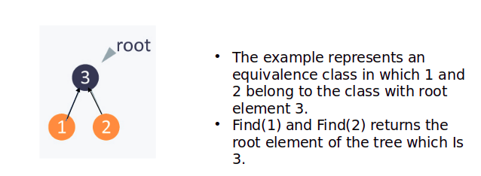
-> The above procedure is implemented using Binary Trees,
where the root element of the tree is the representative of the class.
-> The time complexity of the find algorithm is solved using a method called ‘Path Compaction’.
Example:

Slide 4
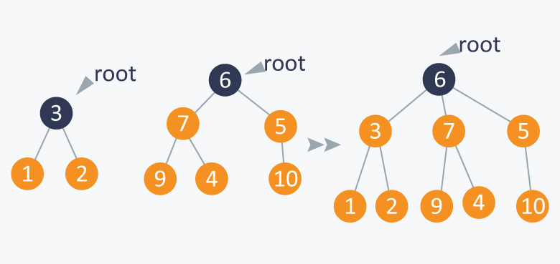
4
The example represents an equivalence class in which 7,5,9,4 and 10 belong to the class with root element 6.
Find(7)=Find(5)=Find(9)=Find(4)=Find(10) returns the root element of the tree which Is 6.
Union(2,4) adds an element 4 to the parent 2.
Find(4)=Find(2)=3.

Slide 5
CODE
#include<stdio.h>
#include<stdlib.h>
#define MAX_SIZE 100
int parent[MAX_SIZE];
typedef struct Node
{
int key;
struct Node *left, *right;
}Node;
Node *newNode(int key)
{
Node *temp = malloc(sizeof(Node));
temp->key = key;
temp->left = temp->right = NULL;
return (temp);
}

Slide 6
void createNode(int parent[], int i, Node *created[], Node **root)
{
if (created[i] != NULL)
return;
created[i] = newNode(i);
if (parent[i] == -1)
{
*root = created[i];
return;
}
if (created[parent[i]] == NULL)
createNode(parent, parent[i], created, root);
Node *p = created[parent[i]];
if (p->left == NULL)
{
p->left = created[i];
}
else
{
p->right = created[i];
}
}

Slide 7
Node *createTree(int parent[], int n)
{
Node *created[n];
for (int i=0; i<n; i++)
created[i] = NULL;
Node *root = NULL;
for (int i=0; i<n; i++)
createNode(parent, i, created, &root);
return root;
}
void inorder(Node *root)
{
if (root != NULL)
{
inorder(root->left);
printf("%d ",root->key);
inorder(root->right);
}
}

Slide 8
int find(int i)
{
while(parent[i]!=-1)
{
i=parent[i];
find(i);
}
return i;
}
int create_parent_array(int n)
{
printf("Enter the elements for the parent array:\n");
for (int i=0;i<n;i++)
{
scanf("%d",&parent[i]);
}
}

Slide 9
int unioni(int i,int j,int n)
{
parent[j]=i;
Node *root1=createTree(parent,n);
inorder(root1);
}
void initialize()
{
for (int i=0;i<sizeof(parent);i++)
parent[i]=-2;
}
int compact_find(int i)
{
int j=i;
while (parent[i]!=-1)
{
i=parent[i];
find(i);
}
int f=j;
while (f!=i)
{
int pf=parent[f];
parent[f]=i;
f=pf;
}
return i;
}

Slide 10
void main()
{
int num,find_ele;
initialize();
printf("\nEnter the number of elements:");
scanf("%d",&num);
create_parent_array(num);
Node *root = createTree(parent, num);
printf("The inorder traversal for the created tree:\n");
inorder(root);
printf("\n");
int choice,no1,no2,flag=0;
for (;;)
{
printf("Press 1 for find operation,2 for union operation and 3 for path compaction:");
scanf("%d",&choice);
switch(choice)
{

Slide 11
case 1:
printf("Enter element to be found:\n");
scanf("%d",&find_ele);
for(int i=0;i<num;i++)
{
if(i==find_ele)
flag=1;
}
if(flag==1)
printf("The element %d belongs to the class with node element %d\n",find_ele,find(find_ele));
else
printf("Element not in the class\n");
break;
case 2:
//num++;
printf("Enter new element to be added:");
scanf("%d",&no1);
printf("Enter parent for the new element:");
scanf("%d",&no2);
num=1+no1;
unioni(no2,no1,num);
break;

Slide 12
case 3:
printf("Enter element to be found:");
scanf("%d",&find_ele);
for(int i=0;i<num;i++)
{
if(i==find_ele)
flag=1;
}
if(flag==1)
printf("The element %d belongs to the class with node element %d\n",find_ele,compact_find(find_ele));
else
printf("Element not in the class\n");
for (int j=0;j<num;j++)
printf("%d ",parent[j]);
printf("\n");
break;
default:
exit(0);
}
}
}

